Slide 1
Regression
Tomas Karpati MD tc.datascience@gmail.com
054-2002430

Slide 2
Regression Models
Regression Models
Linear Regression
Logistic Regression
Poisson Regression
Time Series Analysis - ARIMA

Slide 3
Linear Regression
Linear algebra
(y2 - y1)
m =
(x2 - x1)
Y
(x2,y2)
m(x2 - x1) = (y2 - y1)
(x1,y1)
m
m(x2 - 0) = (y2 - y0)
(x0,y0)
m(x2) + y0 = y2
X
Y = mX + b
-1
0
1
2

Slide 4
Linear Regression
Y
Y = mX + b
Linear function:
f(y) = 𝝱1X + 𝝱0
X

Slide 5
Linear Regression
Linear Regression
slope
intercept
y = wx + b
y = mx + n
y = mx + n
m
y = mx + n
weight
bias
n

Slide 6
Linear Regression
Linear Regression
w = 1
b = 1
w = 1
b = 2
w = 1
b = 3
y = wx + b
w = 1
b = 1
w = 0.5
b = 1
w = 2
b = 1

Slide 7
Linear Regression
Linear Regression
y = wx + b
Sum of Squared Errors
SSE = 𝞢( y - yhat )²
Error
Cost (loss) function

Slide 8
Linear Regression
Least Square Method
(convergence)
Error
Weight

Slide 9
Linear Regression
Linear Regression
Sum of Squares for the mean for the variable y
SS𝞵 = 𝞢( y - 𝞵 )²
Var𝞵 = SS𝞵 / n

Slide 10
Linear Regression
SS𝞵 = 𝞢( y - 𝞵 )²
Var𝞵 = SS𝞵 / n
SSE = 𝞢( y - yhat )²
Var(SSE) = SSE / n
R² = (Var(𝞵) - Var(SSE)) / Var(𝞵)
(Var(𝞵) - Var(SSE)) / (p_{𝞵} - p_{SSE})
F =
Var𝞵 / (n - p_{SSE})
p-value

Slide 11
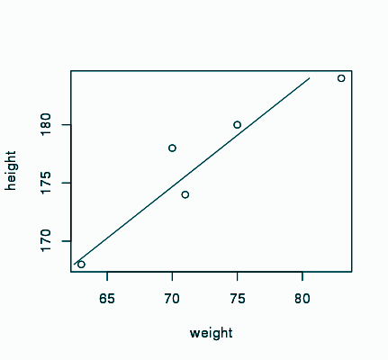
Linear Regression
Height | Weight
180 | 75
174 | 71
184 | 83
168 | 63
178 | 70
Linear function:
f(y) = 𝝱1X + 𝝱0
Pearson correlation: 0.941
R² = 0.8856, Adj R²: 0.8475
weight = 1.13*height - 127.69

Slide 12
Linear Regression
Linear function:
f(y) = 𝝱1X1 + 𝝱2X2 + 𝝱0
Height | Weight | Calories
180 | 75 | 1750
174 | 71 | 1350
184 | 83 | 2120
168 | 63 | 1430
178 | 70 | 1100
weight = 0.88728*height + 0.00625*calories - 94.1577
R² = 0.9571, Adj R²: 0.9143

Slide 13
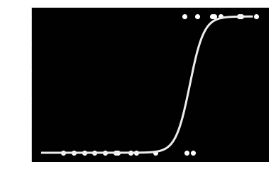
Logistic Regression
Binary Logistic function:
logit(𝞹)=log(𝞹/(1−𝞹))= 𝝱1X1 +…+ 𝝱nXn + 𝝱0
Where π is a probability of "success". The outcome variable is binary (0/1, False/True, No/Yes, etc)
Sigmoid function

Slide 14
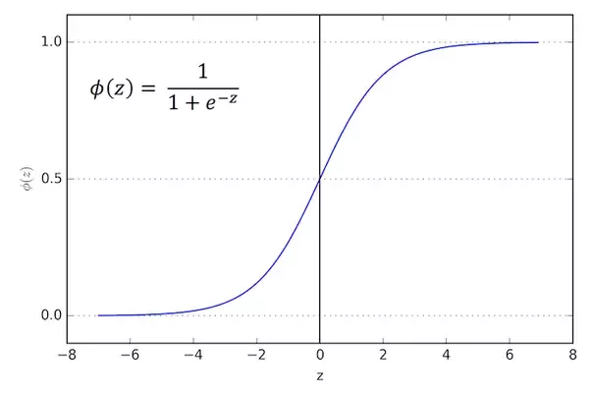
Logistic Models
The formula of logistic regression is:
z = 𝝱1X1 + 𝝱2X2 + 𝝱0
ŷ = 𝛔(z) P(y=1| x)
The sigmoid function is defined as follows:
1
𝛔(Z) =
1 + e^{-Z}

Slide 15
Logistic Regression
In R logistic models are generated using the Generalized Linear Models (GLM):
mod <- glm(y ~ x, family=”binomial”)
The result of the algorithm is the probability of y = 1 given x.
To calculate the predicted category we select a cutoff value (default is 0.5)
To calculate the accuracy of the model we use a contingency table (2x2 table) with the predicted and observed y’s

Slide 16
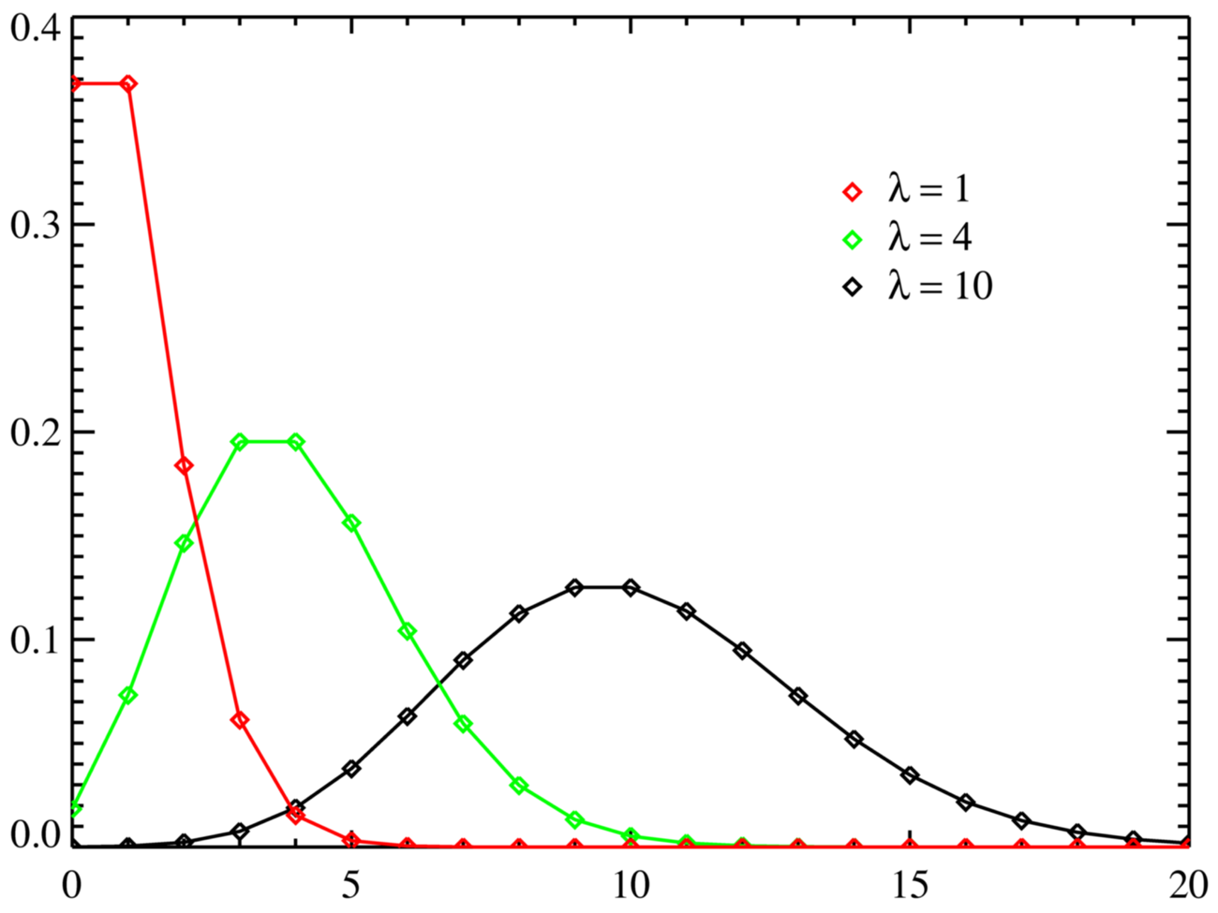
Poisson Regression
Poisson function:
log(μ_{ij}) = λ + λ_{i}^{X1} + λ_{j}^{X2} +…+ λ_{k}^{Xk} +…
The outcome is an ordinal variables (count)
If the mean = variance of the outcome variable we use the log-linear poisson regression [glm(... , family=”poison”)
If the variance > mean we use a negative binomial regression [MASS::glm.nb()]
If the variance < mean (and has high count for zeros, use Zero-inflated regression model [pscl::zeroinfl()]
Poisson regression

Slide 17
Regression Models
Explanatory
vs
Predictive

Slide 18
Regression Models
Generalized linear models (GLM):
f(y) = 𝝱1X1 + 𝝱2X2 + ... + 𝝱nXn + 𝝱0
Usage:
Explanatory: We want to understand the influence of each variable - we focus on the betas - Odds ratios
Predictive: We want to know what will happen - we focus on the f(y)

Slide 19
Regression Models
Risk Ratio (RR):
RR=(a/(a+b))/(c/(c+d))
Odds Ratio (OR):
OR=(a/c)/(b/d)=(a*d)/(b*c)
 | Cases | Controls
Exposed | a | b
Not exposed | c | d
RR = (10/(10+4)/2/(2+8) = (10/14)/(2/10) = 100/28 = 3.6 -> The risk of the exposed is 3.6 times higher than those unexposed
 | Cases | Controls
Exposed | 10 | 4
Not exposed | 2 | 8
OR = (10*8)/(4*2) = 80/8 = 10 -> The odds of exposed is 10 times higher than the odds of unexposed
Notes:
יחס סיכונים = % cases for exposed / % cases for unexposed
יחס סיכויים = % exposed for cases / % exposed for controls

Slide 20
Regression Models
Explanatory:
Risk Ratio (RR)
Odds Ratio (OR)
Linear models: exp(beta) -> Risk Ratio
Logistic models: exp(beta) -> Odds Ratios
Poisson models: exp(beta) -> Risk Ratio

Slide 21
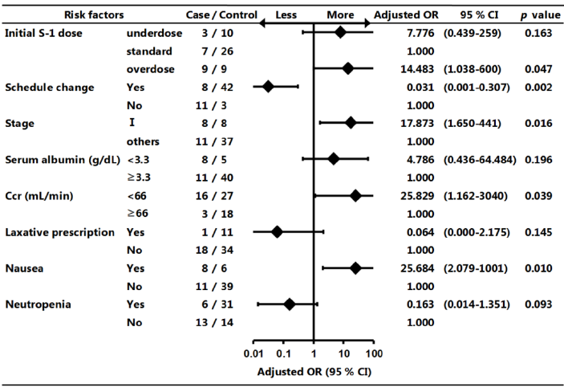
Regression Models

Slide 22
Regression Models
Problems we have to avoid in explanatory models:
Relationship vs Causality
Collinearity (vif)
Beware of confounders (affect both x’s and y)
Drug abuse + Homeless : crime
Age + years of experience : salary

Slide 23
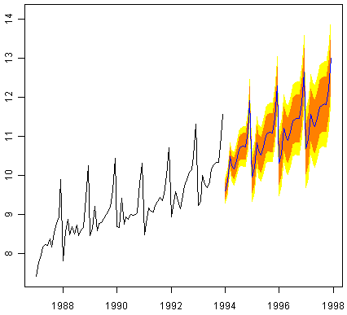
Time-Series models

Slide 24
Time-Series models
Time series data are characterized by four components:
Trend: main direction of the time series
Seasonality: variations occurring at regular time periods
Cyclicity: medium term variations which repeats at irregular times
Irregularity: changes on short irregular time periods (random noise)

Slide 25
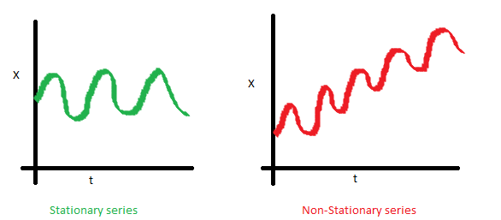
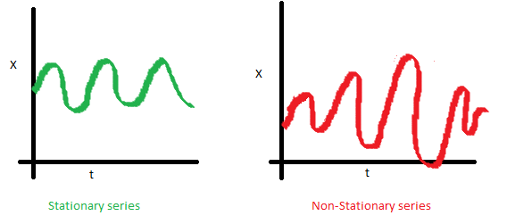
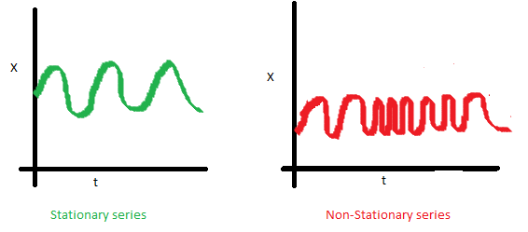
Time-Series models
Autoregressive integrated moving
average (ARIMA).
To apply a regression model to a time-series data the data must be a stationary series:
The mean must be constant and not changing over time
The variance must not change over time
The covariance must not change over time

Slide 26
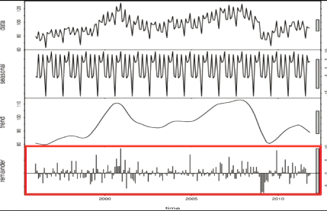

ARIMA
Data
Season
Trend
Noise

Slide 27
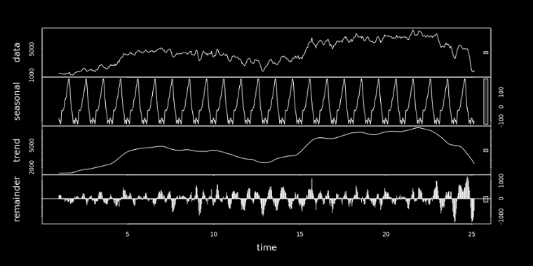
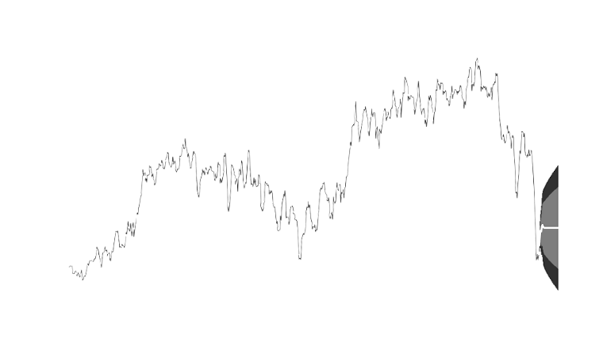
ARIMA
Recomposition
Decomposition

